Slide 1

How to find Assets into Innovation Theater
June 2019

Slide 2
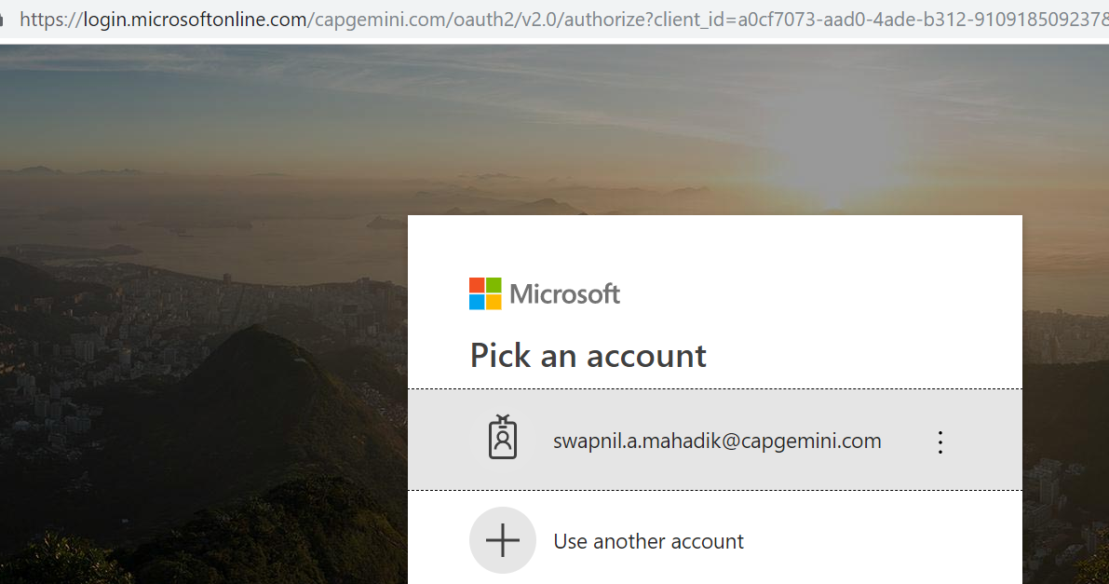
Innovation Theater
Log into Innovation Theater portal. The portal site is https://innovationtheater.Capgemini.com. System will prompt you to select Capgemini domain account to access the portal.

Slide 3
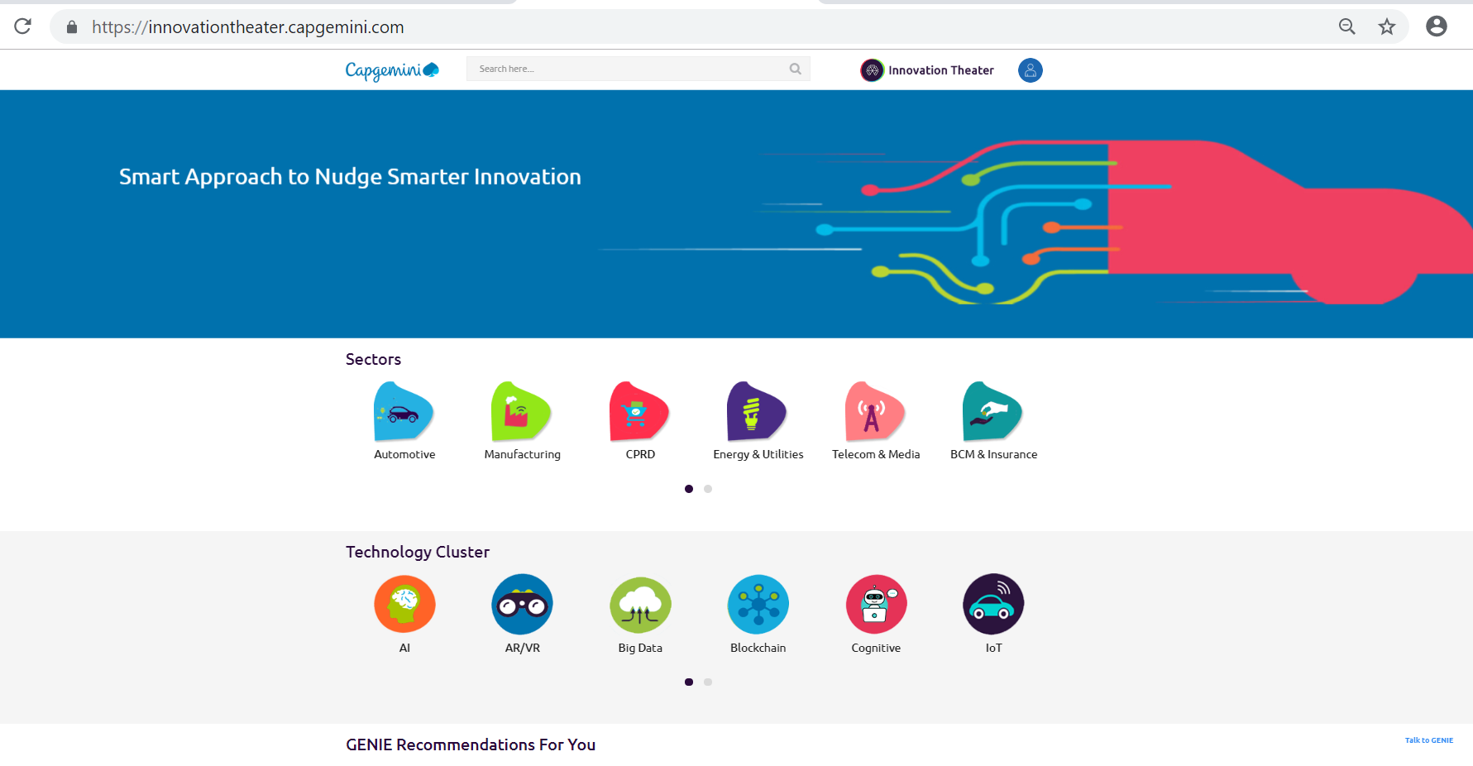
Innovation Theater Portal Home Page

Slide 4

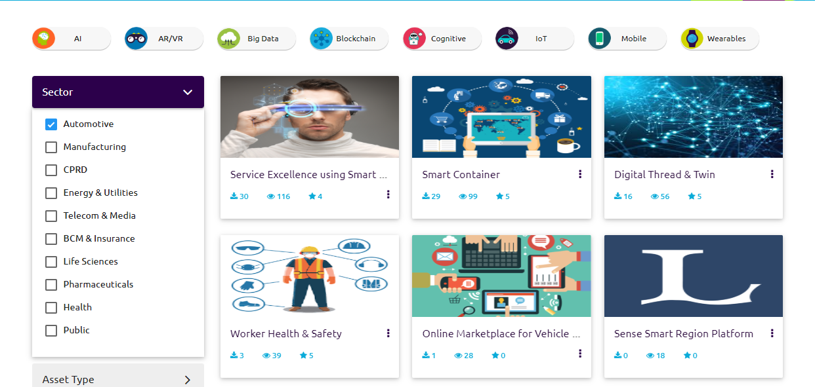
Assets Details
Assets can be search through Sectors and / or Technology Clusters.

Slide 5
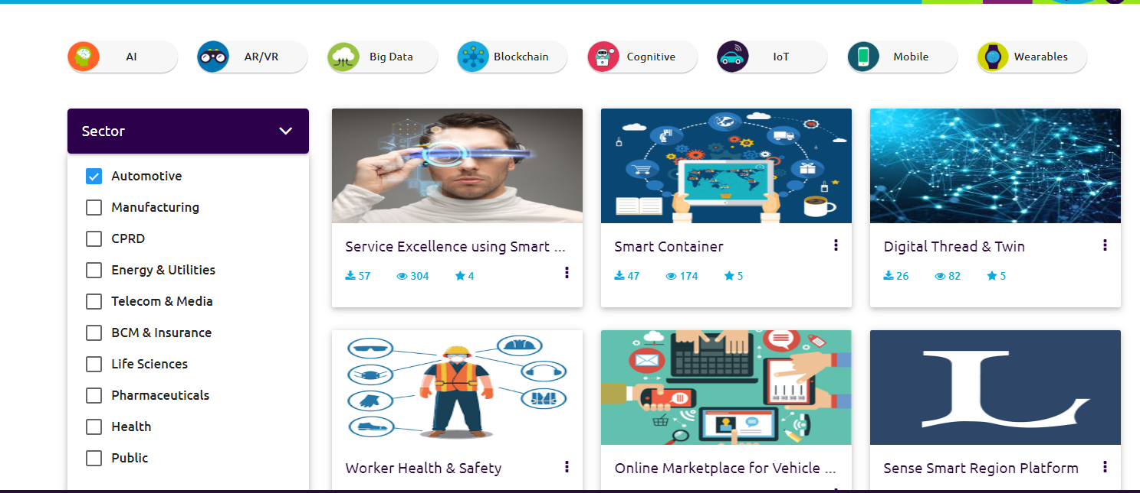
Assets Details
For example : Assets filter on Automotive sectors can be viewed on the page

Slide 6
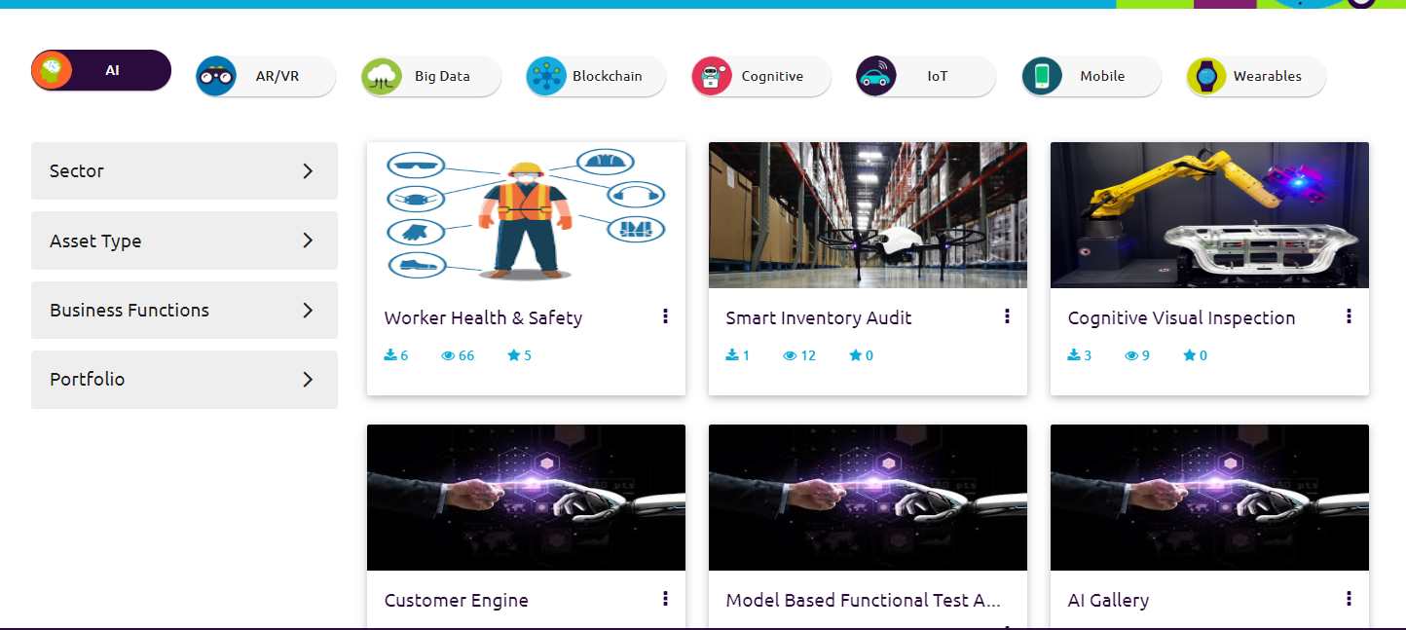
Assets Details
Further Assets can also filter on Technology Cluster ( In below example assets further filtered on AI )

Slide 7
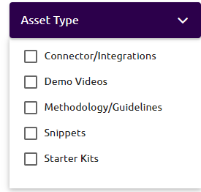
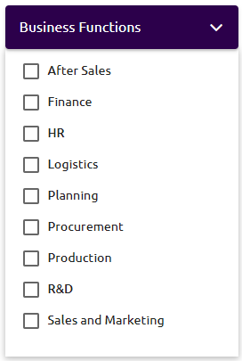
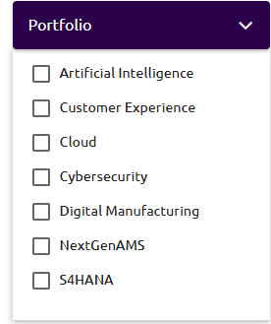
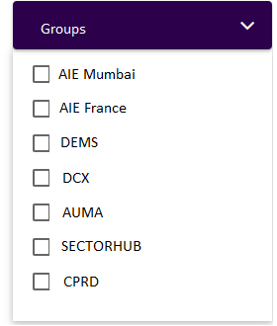
Assets Details
Further filter assets on Type , Business functions and Portfolio

Slide 8
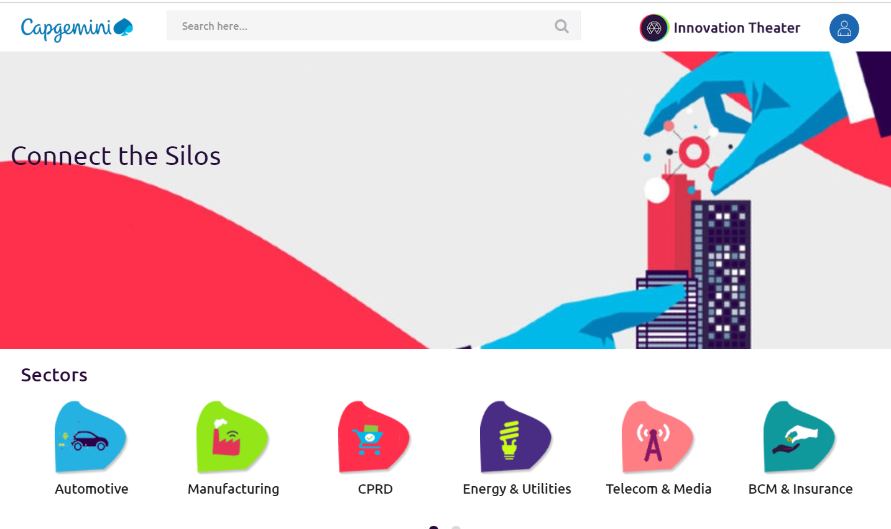
Assets Details
Assets also can be search from Innovation Theater home page.

Slide 9
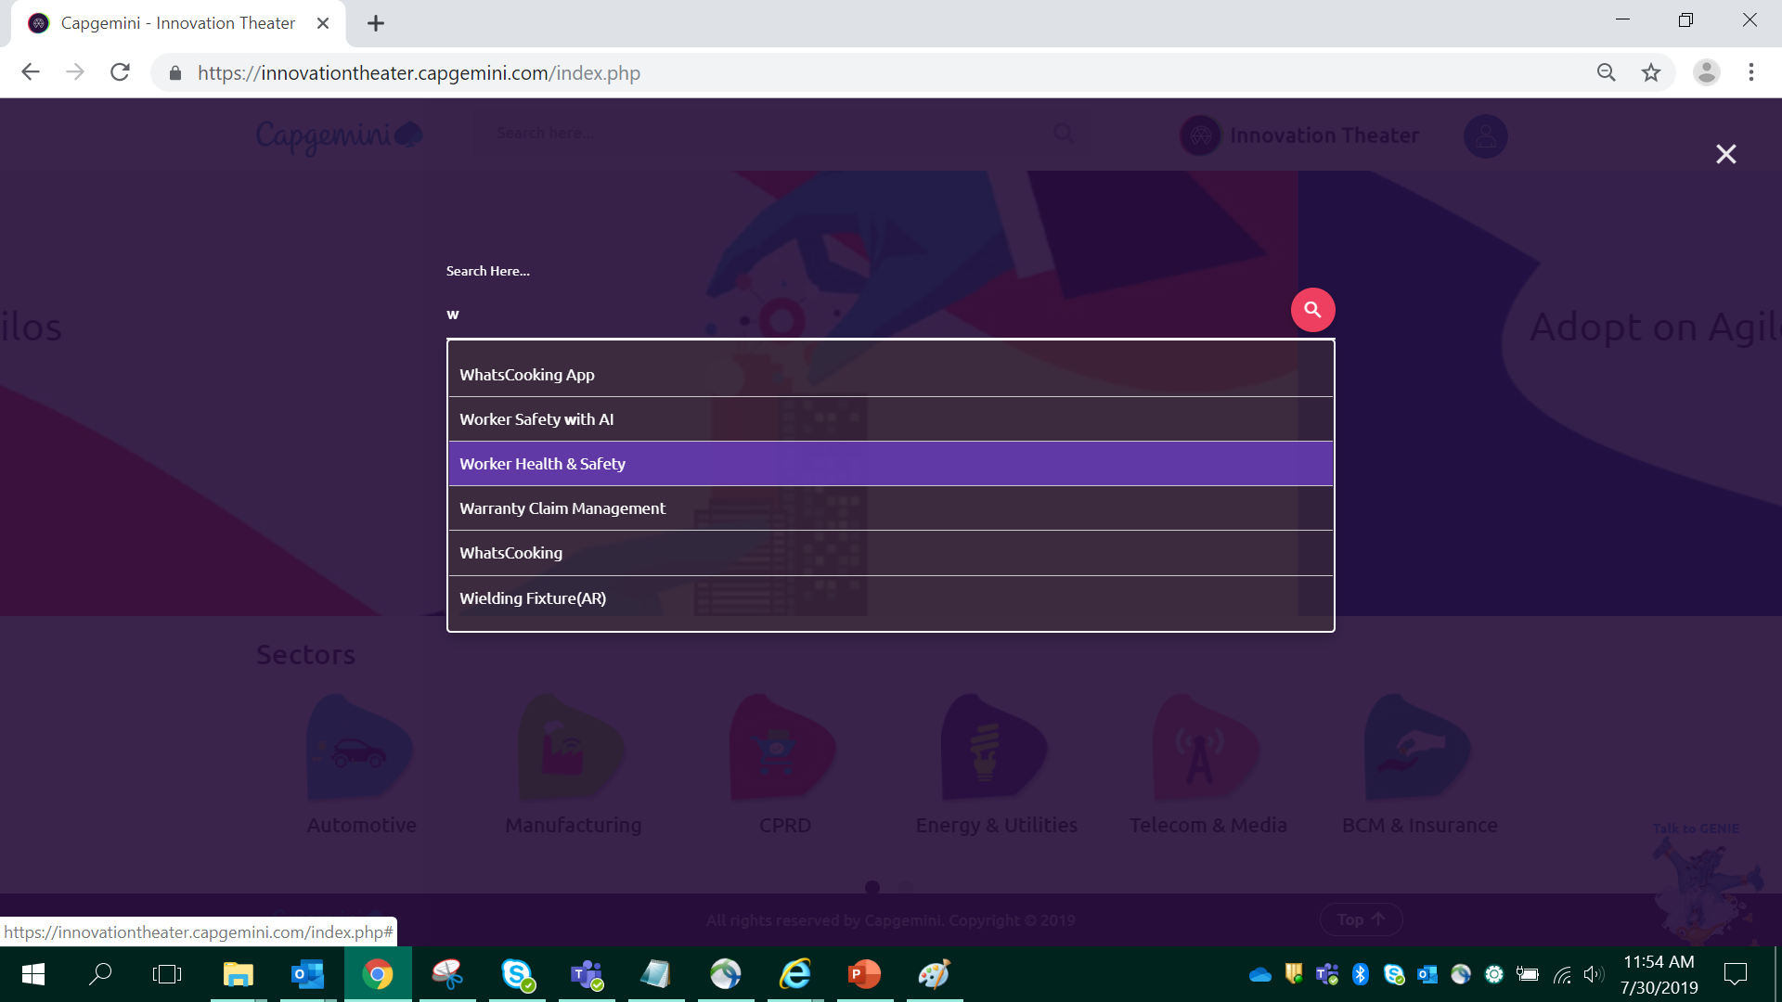
Assets Details
Assets also can be search through search window on Asset Name, Technology, Owner Group etc.

Slide 10
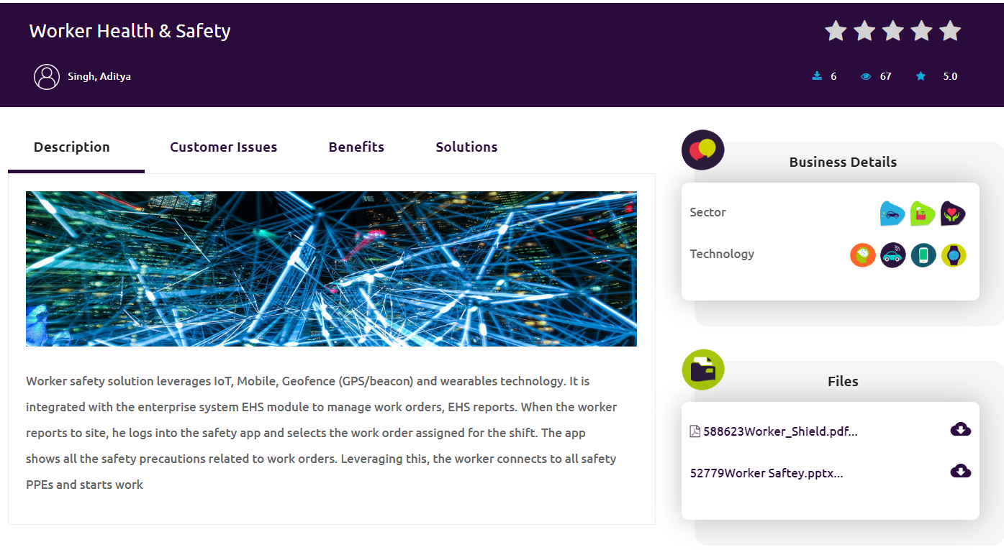
Assets Details
We can see details in Asset as description (Name of the Asset), Customer Issue, Benefits and the solution. On right side of the screen under Business Details section we can see Sector and Technology under which Asset has been stored. In files section we can store support files (pdf, ppt or doc) and demo videos.

Slide 11

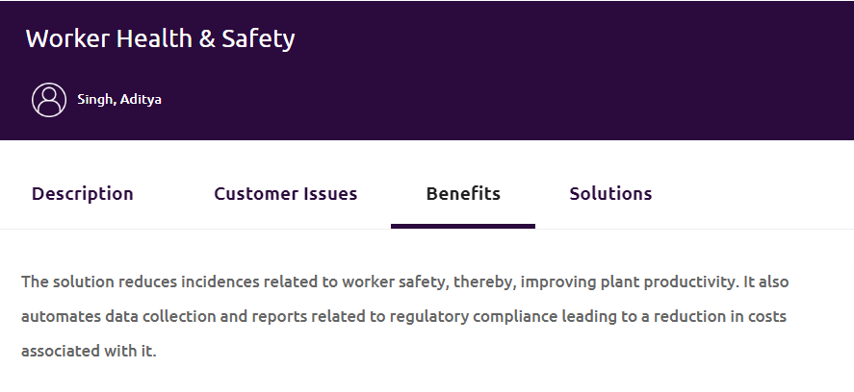
Assets Details
We can see details in Asset as description (Name of the Asset), Customer Issue, Benefits and the solution. On right side of the screen under Business Details section we can see Sector and Technology under which Asset has been stored. In files section we can store support files (pdf, ppt or doc) and demo videos.

Slide 12
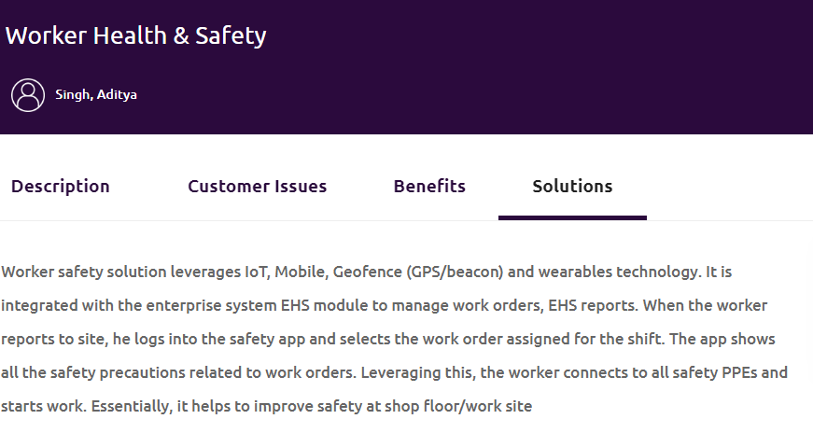
Assets Details
We can see details in Asset as description (Name of the Asset), Customer Issue, Benefits and the solution. On right side of the screen under Business Details section we can see Sector and Technology under which Asset has been stored. In files section we can store support files (pdf, ppt or doc) and demo videos.

Slide 13
Find Assets Workflow
Filter Assets
User
Log into Innovation Theater
https://Innovationtheater.Capgemini.com
Click on Sector / Technology Cluster
Filter on Asset Type
Filter on Business Functions
Filter on portfolio / Groups
Business Layer
Verified Assets
Innovation Theater
View Assets

Slide 14
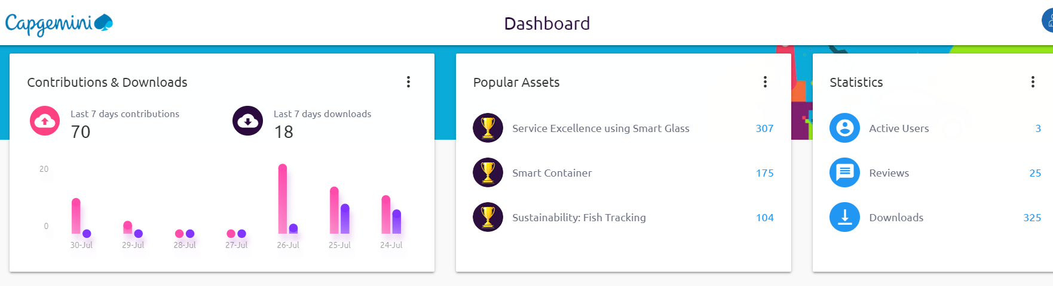
DashBoard
In Dashboard section, the details of the Popular Assets based on number of views, statistics about the Assets and assets downloaded and uploaded in last 7 days.

Slide 15
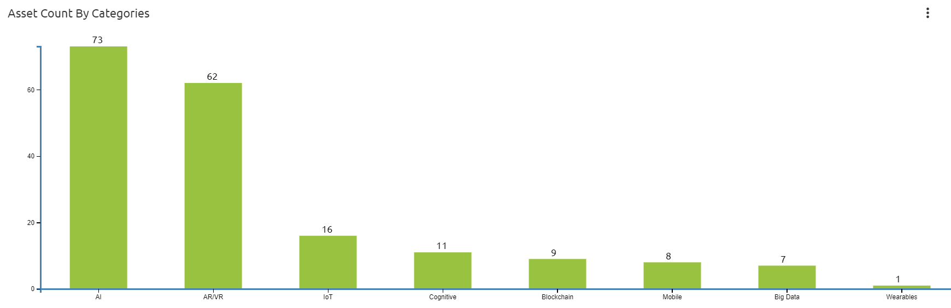
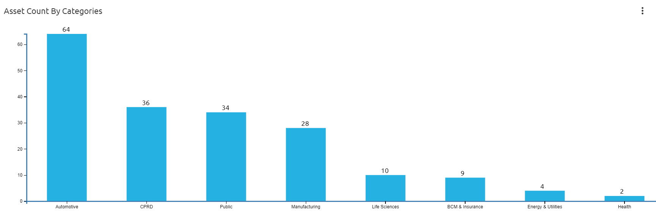
DashBoard

Slide 16
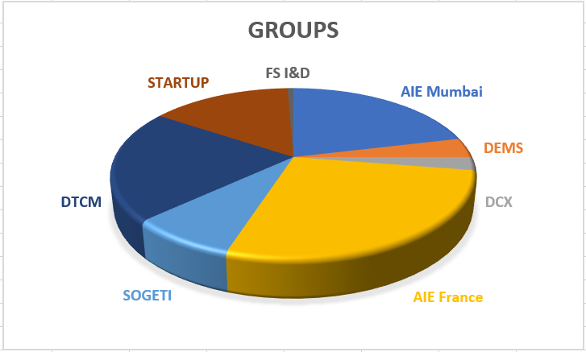
DashBoard
A pie charts based on the Asset Owner Groups, Sector and Technology

Slide 17
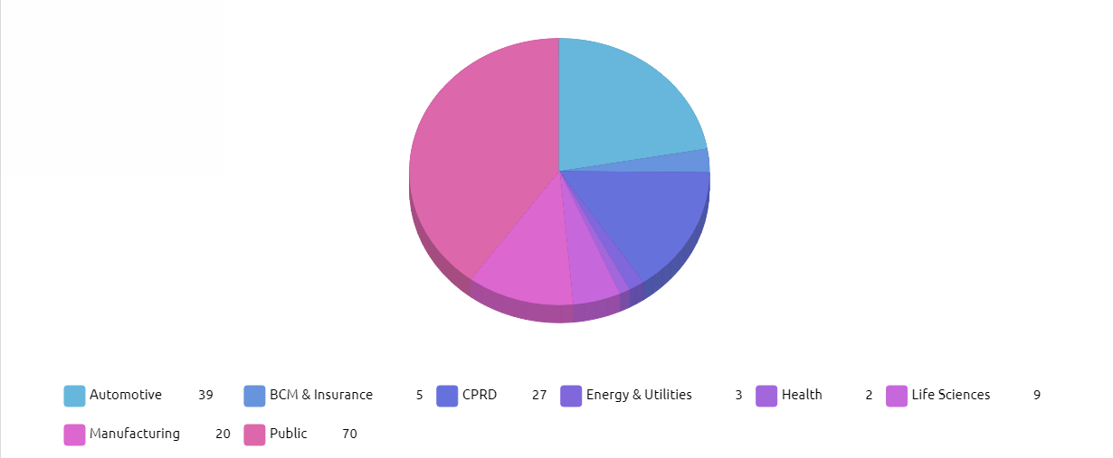
DashBoard
A pie charts based on the Asset Owner Groups, Sector and Technology

Slide 18
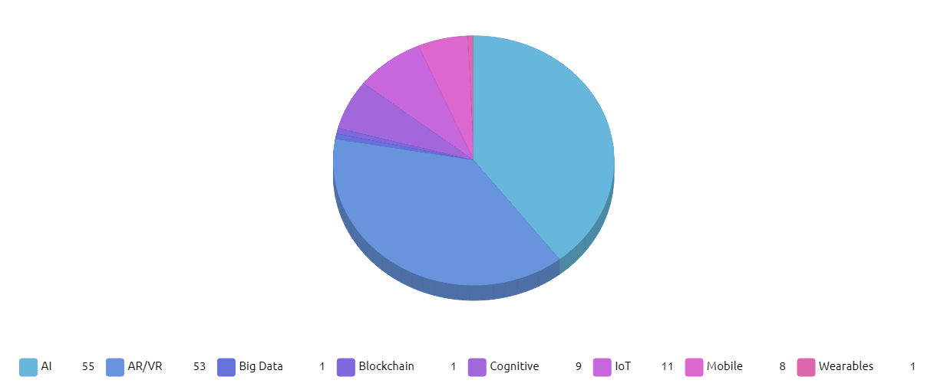
DashBoard
A pie charts based on the Asset Owner Groups, Sector and Technology

